Slide 1

VICTORIA LOO
26TH JULY 2021
VICTORIA LOO | 26TH JULY 2021

Slide 2

BUSINESS CONTEXT
WHAT IS DIABETES?
Diabetes is a chronic health condition where blood glucose is too high.
If not managed well, can lead to serious health problems, such as heart disease, kidney damage, vision loss, limb amputation etc.
DIABETES IN AUSTRALIA?
Around 1.8 million Australians have diabetes.
280 Australians develop diabetes every day.
Total annual cost impact of diabetes in Australia estimated at $14.6 billion.
VICTORIA LOO | 26TH JULY 2021
Notes:
‹#›

Slide 3

BUSINESS QUESTIONS
CAN WE USE STATISTICAL MODELLING TO PREDICT AND PREVENT EARLY ONSET DIABETES?
Is there a correlation between specific features and the probability of diabetes?
VICTORIA LOO | 26TH JULY 2021
Notes:
‹#›

Slide 4

DATA PIPELINE
Data Acquisition
Data Exploration
Data Visualisation
Hypothesis Testing
Summary
VICTORIA LOO | 26TH JULY 2021
Notes:
‹#›

Slide 5

DATA OVERVIEW
Observation: 768
Unique Features: 8
Source: National Institute of Diabetes and Digestive and Kidney Diseases
DATA FEATURES
Pregnancies | Number of times pregnant
Glucose | Plasma glucose concentration (mg/dL) (2 hours after Oral Glucose Tolerance Test)
Blood Pressure | Diastolic blood pressure (mm Hg)
Skin Thickness | Triceps skin fold thickness (mm)
Insulin | 2-Hour serum insulin (mu U/ml)
BMI | Body mass index (weight in kg/(height in m)^2)
Diabetes Pedigree Function | Diabetes Pedigree Function
Age | Years
Outcome | Diabetes (Yes / No)
VICTORIA LOO | 26TH JULY 2021
Notes:
‹#›

Slide 6
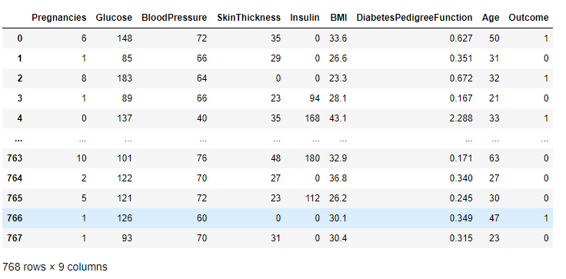
DATA OVERVIEW
Data Table
VICTORIA LOO | 26TH JULY 2021
Notes:
‹#›

Slide 7
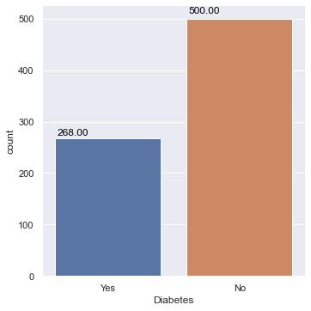
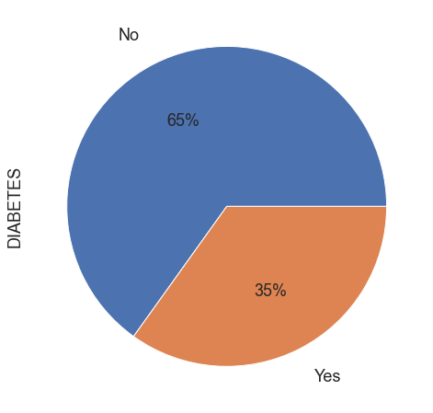
DATA OVERVIEW
Number of Diabetics in Dataset
Percentage of Diabetics in Dataset
VICTORIA LOO | 26TH JULY 2021
Notes:
‹#›

Slide 8
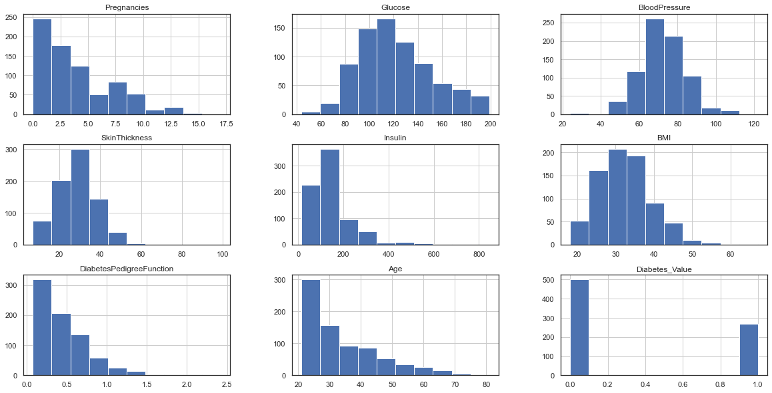
DATA OVERVIEW
Population Distribution of each Feature
VICTORIA LOO | 26TH JULY 2021
Notes:
‹#›

Slide 9

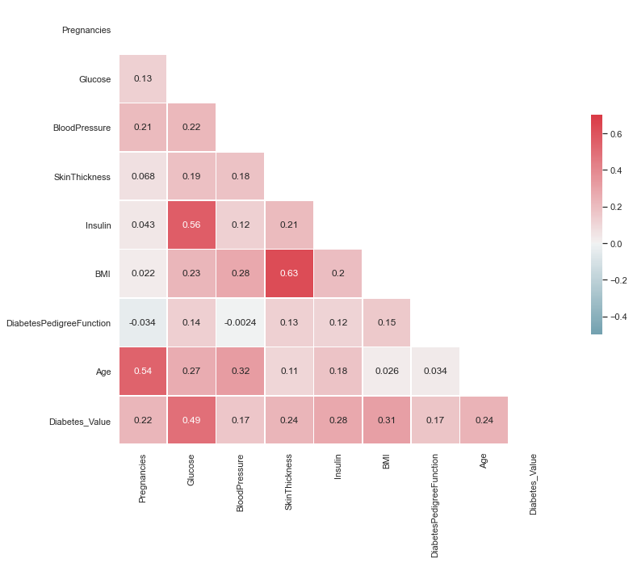
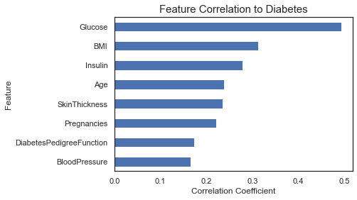
EXPLORATORY DATA ANALYSIS
Correlation Analysis
VICTORIA LOO | 26TH JULY 2021
Notes:
‹#›

Slide 10
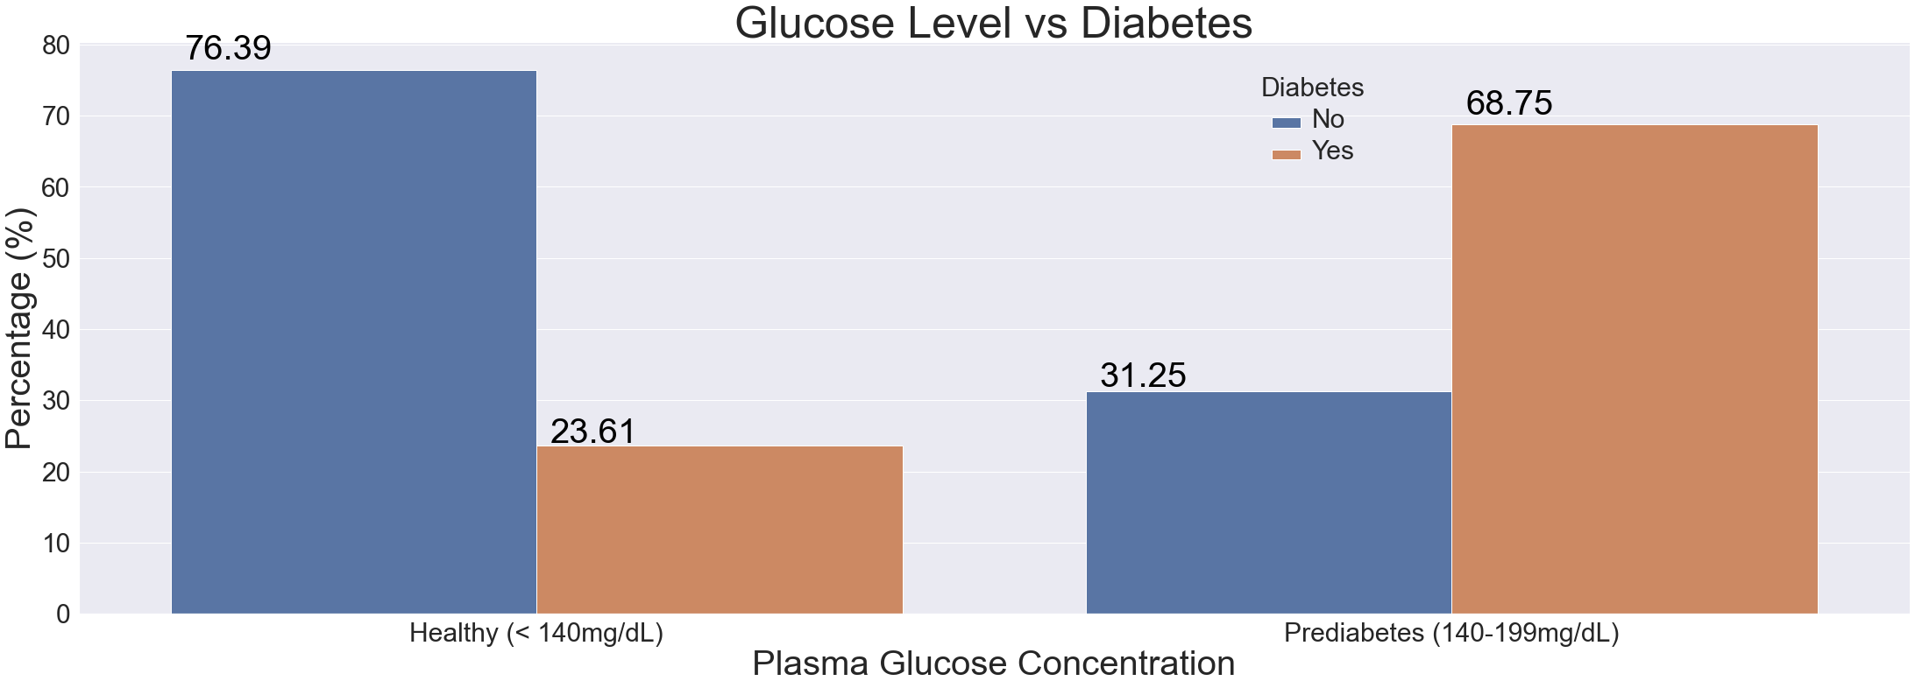
EXPLORATORY DATA ANALYSIS
VICTORIA LOO | 26TH JULY 2021
Notes:
‹#›

Slide 11
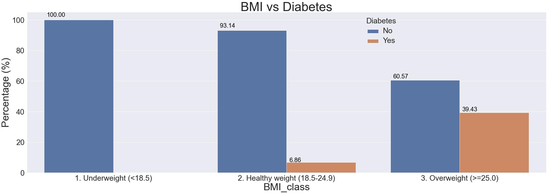
EXPLORATORY DATA ANALYSIS
VICTORIA LOO | 26TH JULY 2021
Notes:
‹#›

Slide 12
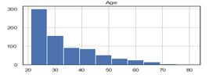
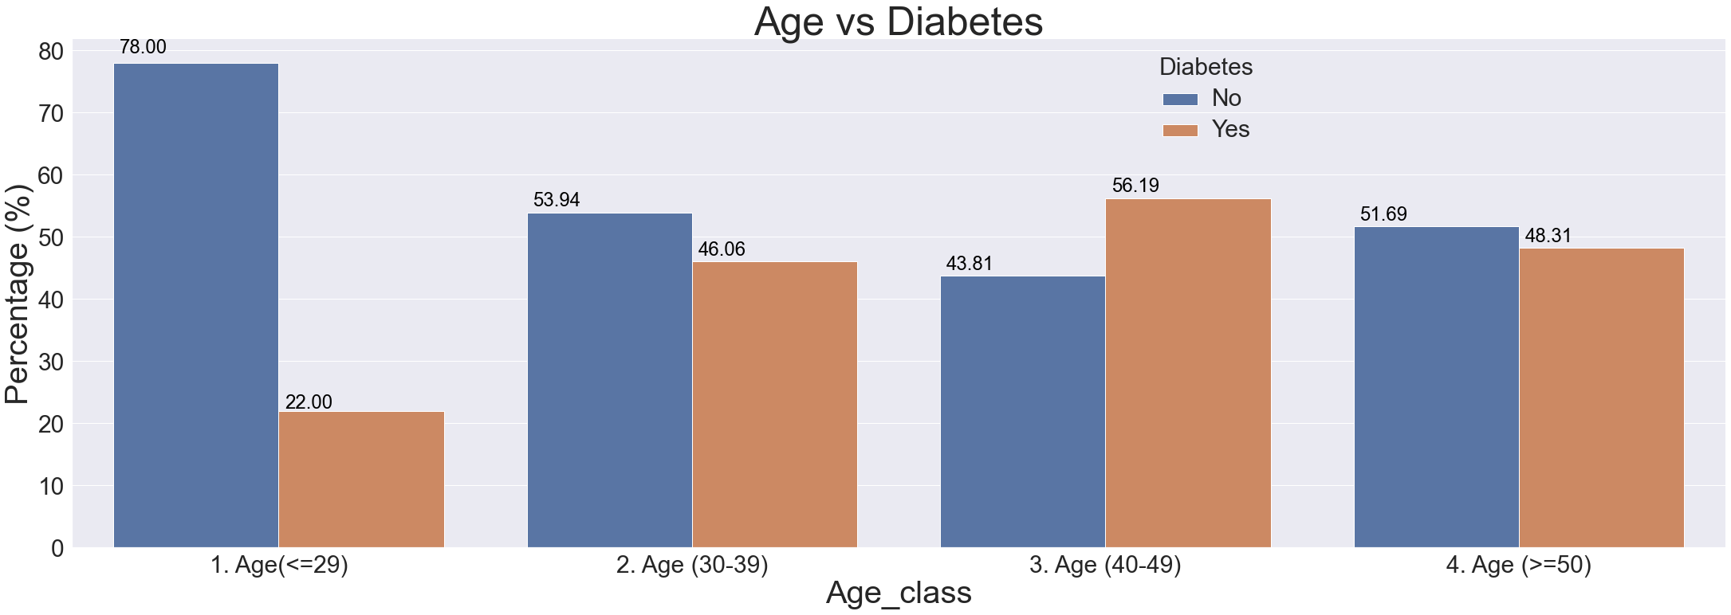
EXPLORATORY DATA ANALYSIS
VICTORIA LOO | 26TH JULY 2021
Notes:
‹#›

Slide 13
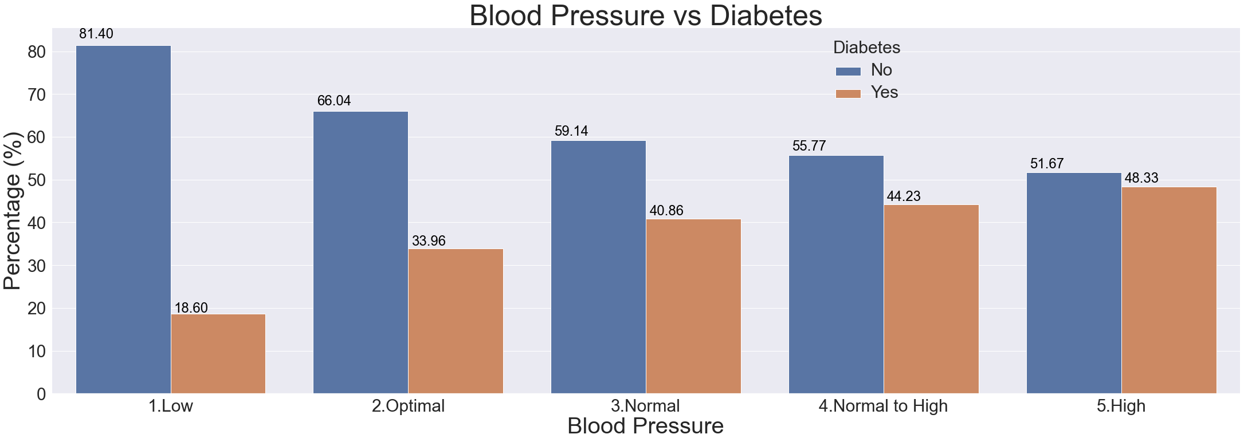
EXPLORATORY DATA ANALYSIS
VICTORIA LOO | 26TH JULY 2021
Notes:
‹#›

Slide 14
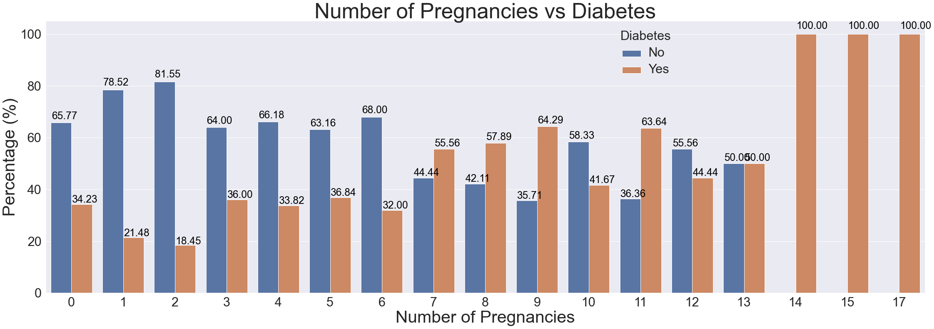
EXPLORATORY DATA ANALYSIS
VICTORIA LOO | 26TH JULY 2021
Notes:
‹#›

Slide 15

HYPOTHESIS TESTING: AGE ONE TAILED TWO SAMPLES T-TEST
NULL HYPOTHESIS: Diabetics are younger compared to non diabetics.
ALTERNATIVE HYPOTHESIS: Diabetics are older compared to non diabetics.
SIGNIFICANCE P-VALUE: 0.05
OUTCOME: Calculated P-Value is 5.56e-08, we reject Null Hypothesis.
CONCLUSION: Diabetics are older compared to non diabetics.
VICTORIA LOO | 26TH JULY 2021
Notes:
‹#›

Slide 16
HYPOTHESIS TESTING: BLOOD PRESSURE ONE TAILED TWO SAMPLES T-TEST
NULL HYPOTHESIS: BP is lower in diabetics compared to non diabetics.
ALTERNATIVE HYPOTHESIS: BP is higher in diabetics compared to non diabetics.
SIGNIFICANCE P-VALUE: 0.05
OUTCOME: Calculated P-Value is 1.36e-11, we reject Null Hypothesis.
CONCLUSION: BP is higher in diabetics.
VICTORIA LOO | 26TH JULY 2021

Slide 17
HYPOTHESIS TESTING: PREGNANCY ONE TAILED TWO SAMPLES T-TEST
NULL HYPOTHESIS: Number of pregnancies is lower in diabetics.
ALTERNATIVE HYPOTHESIS: Number of pregnancies is higher in diabetics.
SIGNIFICANCE P-VALUE: 0.05
OUTCOME: Calculated P-Value is 2.41e-06, we reject Null Hypothesis.
CONCLUSION: Number of pregnancies is higher in diabetics compared to non diabetics.
VICTORIA LOO | 26TH JULY 2021

Slide 18

SUMMARY & NEXT STEPS
In summary, all given features are positively correlated to a diabetic. And some stronger than others. For example Glucose Level & BMI.
We can predict whether a person is likely to be diabetic based on a set of underlying features.
Next steps, further analysis is required in order to create a model to predict diabetics given a set existing features.
VICTORIA LOO | 26TH JULY 2021
Notes:
‹#›

